Slide 1

Natural Language Processing Project
Recipe Search Application
Presenter: 20140313 양인수
TEAM 자연어버억
MEMBERS:
20163704 박주현
20164245 홍진
20140490 이동규
20176058 박시현
20142748 이강희
20140313 양인수
Notes:
本PPT模板部分元素使用了幻灯片母版制作。如果需要修改，点击-视图-幻灯片母版-修改；完成后关闭编辑母版即可。

Slide 2
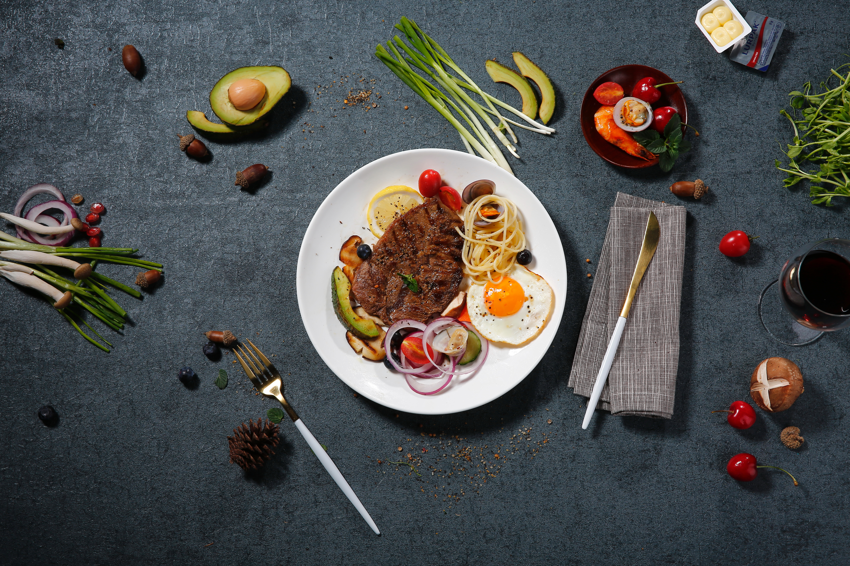
01 Introduction
02 Algorithm
CONTENTS
03 Evaluation
04 Demo

Slide 3
01
Introduction
Topic
Development

Slide 4



Topic
NL query
Matching
Dish
Building a system that understands natural language query.
Search also by the ingredients.

Slide 5

Development
Web Environment
Language Processor
- User-friendly interface
- Query Processor
- Takes in user query
- Language Model
- Displays top-matching results
- IR Evaluation System

Slide 6
02
Algorithms
Query
Modeling
Matching

Slide 7
Query Preprocessing
Query:
Tasty
Boiling
Chicken
Soup
NLTK Library
Delicious
Yummy
Appetizing
Savory
Hot
Warm
Sizzling
*randomly generates 10 queries
Delicious Hot
Chicken Soup
Delicious Warm
Chicken Soup
result
Yummy Hot
Chicken Soup
Yummy Warm
Chicken Soup
Notes:
Yummly, allrecipes, Damn Delicous에서 요리에 대한 정보를 가져왔습니다.

Slide 8
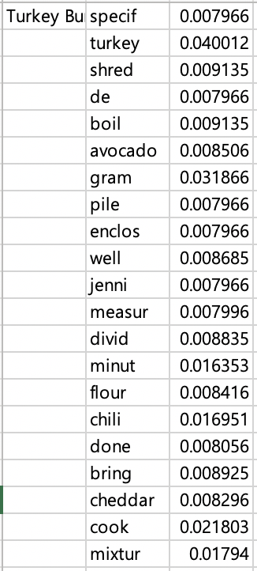
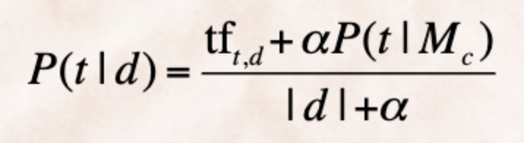
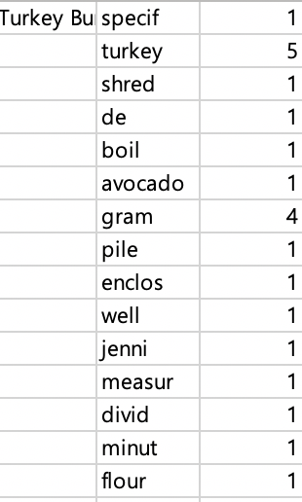
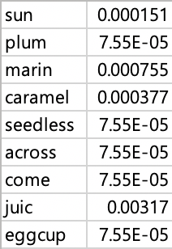
Modeling
Dirichlet Smoothing:
P(t|d)
TF
DF
*a Value defaulted by 0.5
Notes:
Yummly, allrecipes, Damn Delicous에서 요리에 대한 정보를 가져왔습니다.

Slide 9
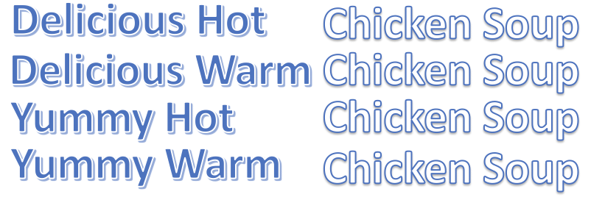
Matching
P(t|d)
- Takes the average of the randomly created 10 queries.
Notes:
Yummly, allrecipes, Damn Delicous에서 요리에 대한 정보를 가져왔습니다.

Slide 10
03
Evaluation
Model Improvement
Evaluation

Slide 11
Model Improvement
Title
Desc
Ingred
Recipe
01
02
03
04
Q: Warm soup?
Zaru Soba
Notes:
Yummly, allrecipes, Damn Delicous에서 요리에 대한 정보를 가져왔습니다.

Slide 12
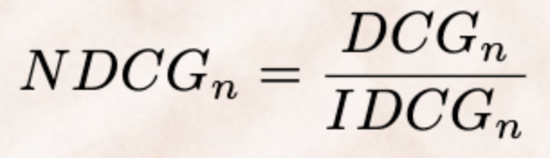
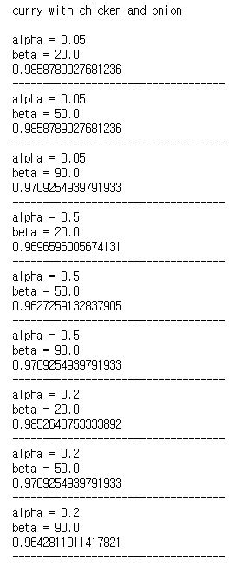
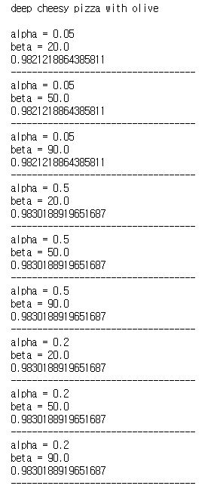
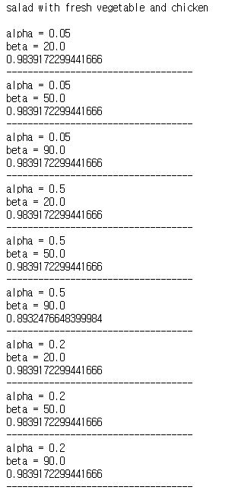
Evaluation
alpha: constant in Dirichelet smoothing
(Think as a weight figure for DF)
beta: weight figure for recipe component
Notes:
Yummly, allrecipes, Damn Delicous에서 요리에 대한 정보를 가져왔습니다.

Slide 13
04
Demo
http://salmon-buck.herokuapp.com/

Slide 14
Thank You.
This is the end of our presentation.
Notes:
本PPT模板部分元素使用了幻灯片母版制作。如果需要修改，点击-视图-幻灯片母版-修改；完成后关闭编辑母版即可。

